Slide 1
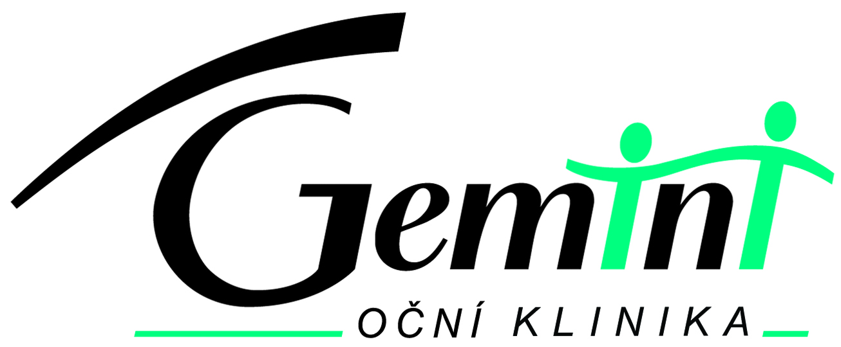
REFRACTIVE
ERRORS & SURGERY
www.lasik.cz
Author : STODULKA P., MD, PhD.
chief surgeon of Gemini Eye Clinic
www.gemini.cz
Notes:
1

Slide 2
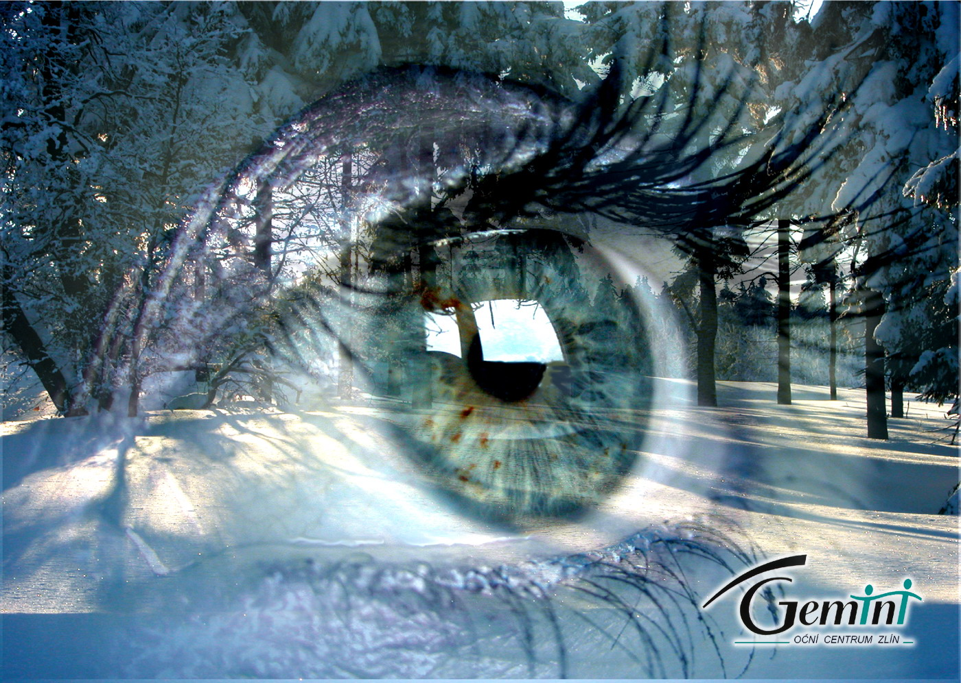
REFRACTIVE ERRORS & SURGERY
STODULKA P.
Zlin, Czech Republic
www.lasik.cz
EYE CLINIC ZLIN

Slide 3
Refraction
Objective – from the device
Subjective – verified by your own vision
Notes:
4

Slide 4
Visual acuity
Uncorrected – no corrective glass
Corrected – with corrective glass
Notes:
4

Slide 5
Snellen’s visual chart
T
F U
N O V
V P O Z
N C U F O D
L P V N H F O
F C U F O V P T
60
36
24
12
10
7,5
6
Notes:
1

Slide 6
Snellen’s visual chart
T
F U
N O V
V P O Z
N C U F O D
L P V N H F O
F C U F O V P T
60
36
24
12
10
7,5
6
Notes:
1

Slide 7
Snellen’s visual chart
T
F U
N O V
V P O Z
N C U F O D
L P V N H F O
F C U F O V P T
V 6/60 = 0,1
60
36
24
V 6/12 = 0,5
12
10
7,5
V 6/6 = 1,0
6
Notes:
1

Slide 8
REFRACTIVE ERRORS
1.
2.
3.
4.
Notes:
4

Slide 9
REFRACTIVE ERRORS
1. MYOPIA
2.
3.
4.
Notes:
4

Slide 10
REFRACTIVE ERRORS
1. MYOPIA
2. HYPEROPIA
3.
4.
Notes:
4

Slide 11
REFRACTIVE ERRORS
1. MYOPIA
2. HYPEROPIA
3. ASTIGMATISM
4.
Notes:
4

Slide 12
REFRACTIVE ERRORS
1. MYOPIA
2. HYPEROPIA
3. ASTIGMATISM
4. PRESBYOPIA
Notes:
4

Slide 13
REFRACTIVE ERRORS
1. MYOPIA - long eye
2. HYPEROPIA
3. ASTIGMATISM
4. PRESBYOPIA
Notes:
4

Slide 14
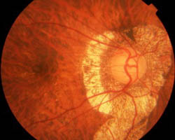
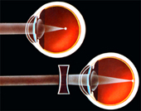
MYOPIA
Notes:
14
4
Myopic eye can not see sharp because the light reys join in front of the retina of the macula lutea. So the distat point or picture is blurred.
This refractive error we improve with divergent lens.
Thats all is because the myopic eye is too big. It is bigger than normal emetropic eye, so the reys cannot rich the retina
Hëre we can see the fundus of myopic eye. Retina is thin. Its expandet in the big eye.

Slide 15
REFRACTIVE ERRORS
1. MYOPIA - long eye
2. HYPEROPIA
3. ASTIGMATISM
4. PRESBYOPIA
Notes:
4

Slide 16
REFRACTIVE ERRORS
1. MYOPIA - long eye
2. HYPEROPIA – short eye
3. ASTIGMATISM
4. PRESBYOPIA
Notes:
4

Slide 17
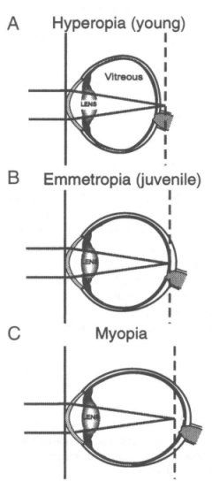
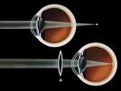
HYPEROPIA
Notes:
17
4
Hypermetropic eye is the oposite of myopic eye. Its small and thats why the light reys go throught the retina and immaginary they join behind of retinal point of sharp vision. We use convex lens for correction into spectacles
Hypermetropic eye cannot see sharp for long distenc not even for near distance. The object is more cloudy when its closer to the eye.

Slide 18
REFRACTIVE ERRORS
1. MYOPIA - long eye
2. HYPEROPIA – short eye
3. ASTIGMATISM
4. PRESBYOPIA
Notes:
4

Slide 19
REFRACTIVE ERRORS
1. MYOPIA - long eye
2. HYPEROPIA – short eye
3. ASTIGMATISM – asymmetric cornea
4. PRESBYOPIA
Notes:
4

Slide 20
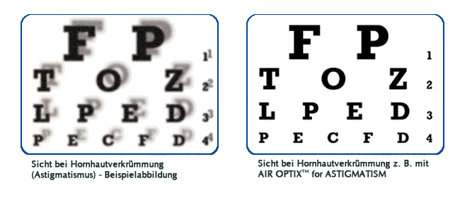
ASTIGMATISM
Notes:
20
4
Next slade show us astigmatismus. On the picure you can see that the surface of the eye is not smooth Mostly the shape of cornea is not regular
Reys bend in wrong angle
The vision is sometimes double, sometimes we can see the shadows , we¨need the thoric glass for corection

Slide 21
REFRACTIVE ERRORS
1. MYOPIA - long eye
2. HYPEROPIA – short eye
3. ASTIGMATISM – asymmetric cornea
4. PRESBYOPIA –
Notes:
4

Slide 22
REFRACTIVE ERRORS
1. MYOPIA - long eye
2. HYPEROPIA – short eye
3. ASTIGMATISM – asymmetric cornea
4. PRESBYOPIA –
decreased accommodation, age > 40
Notes:
4

Slide 23
CORRECTIONS
1. SPECTACLES
2. CONTACT LENSES
3. REFRACTIVE SURGERY
Notes:
4

Slide 24
REFRACTIVE SURGERY
LASIK - laser under surface:
a) mechanical microkeratome
b) femtosecond laser
2. Surface ablation (PRK, lasek)
3. Phakic intraocular lenses
4. Refractive lens exchange
5. Arcuate keratotomy
6. Conductive keratoplasty
Notes:
4

Slide 25
History of laser refractive surgery
1983 - New York, IBM + Dr. Trokel
1989 - first laser refractive surgery on human sighted eye
1991 - first laser refractive surgery in Czechoslovakia
(Zlin, Dr. Smecka)
1995 - first LASIK in Czech Republic
(Zlin, Dr. Stodulka)
1997 - first laser thermokeratoplasty in Czech Rep.
(Brno, Dr. Utrata)
2004 - first epi-lasik in Czech Republic
(Zlin, Dr. Stodulka)
2006 - first lasik with femtosecond laser in Czech Republic
(Zlin, Dr. Stodulka)
Notes:
4

Slide 26
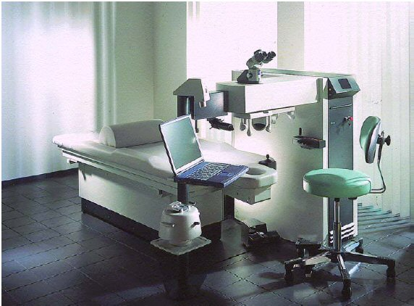
Excimer
laser

Slide 27
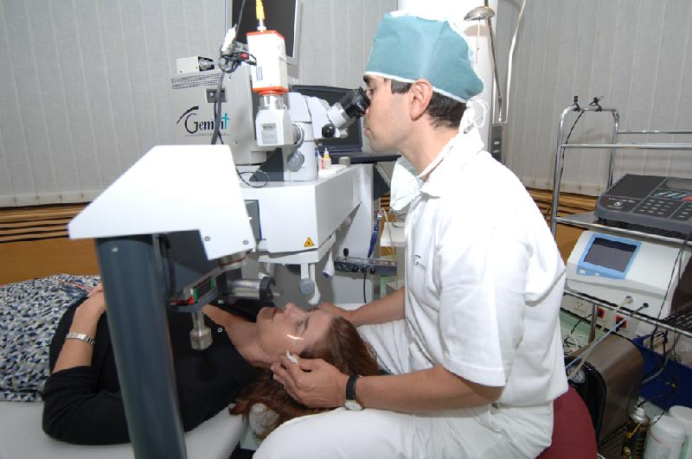
LASIK
Notes:
4

Slide 28
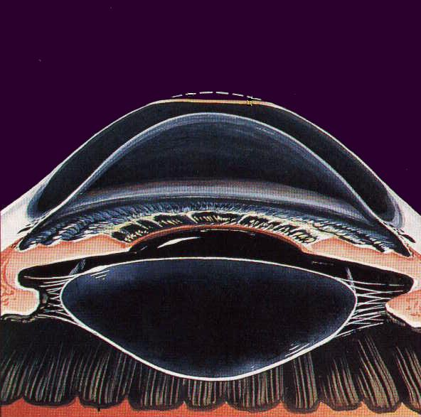

Slide 29
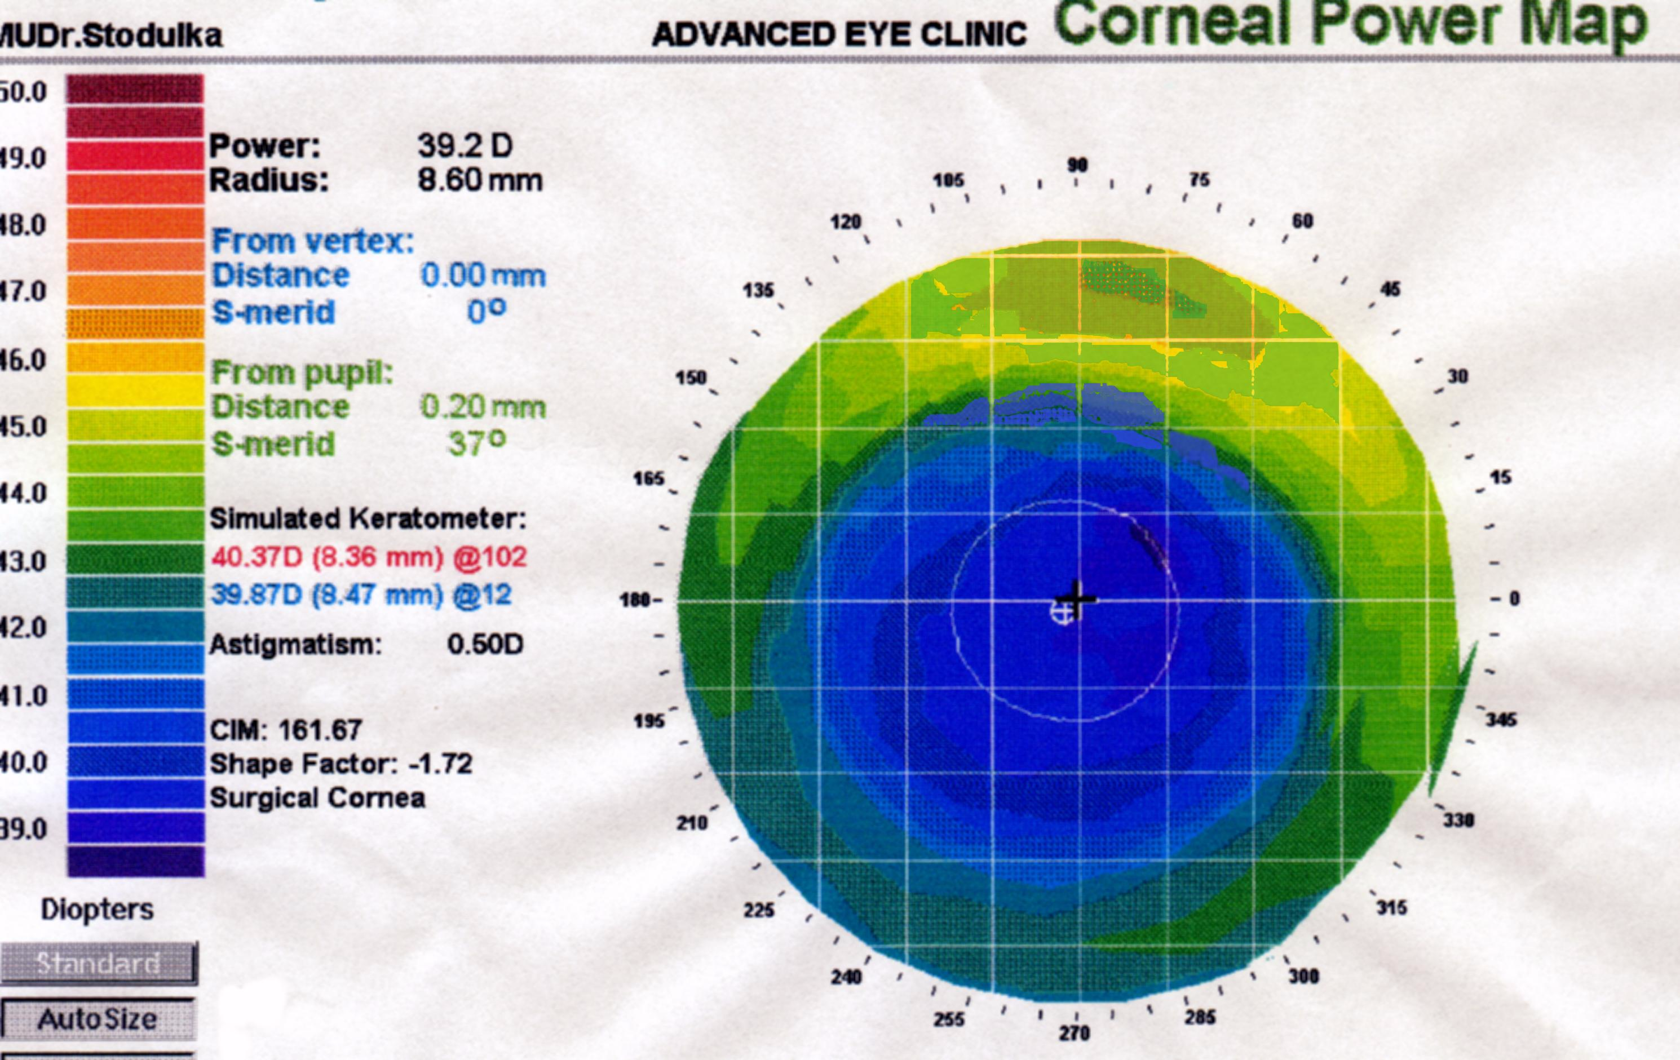

Slide 30
REFRACTIVE SURGERY
laser correction of corneal curvature
a) under the surface (stromal) – LASIK, femto LASIK, Relex
b) surface (under the epithelium) - PRK, LASEK
2. corneal incisions - keratotomy – diamond knife, laser
3. intraocular lens – phakic lens
4. refractive lens exchange – similar to cataract surgery
Notes:
4

Slide 31
REFRACTIVE SURGERY
laser correction of corneal curvature
a) under the surface (stromal) – LASIK, femto LASIK, Relex
b) surface (under the epithelium) - PRK, LASEK
2. corneal incisions - keratotomy – diamond knife, laser
3. intraocular lens – phakic lens
4. refractive lens exchange – similar to cataract surgery
Notes:
4

Slide 32
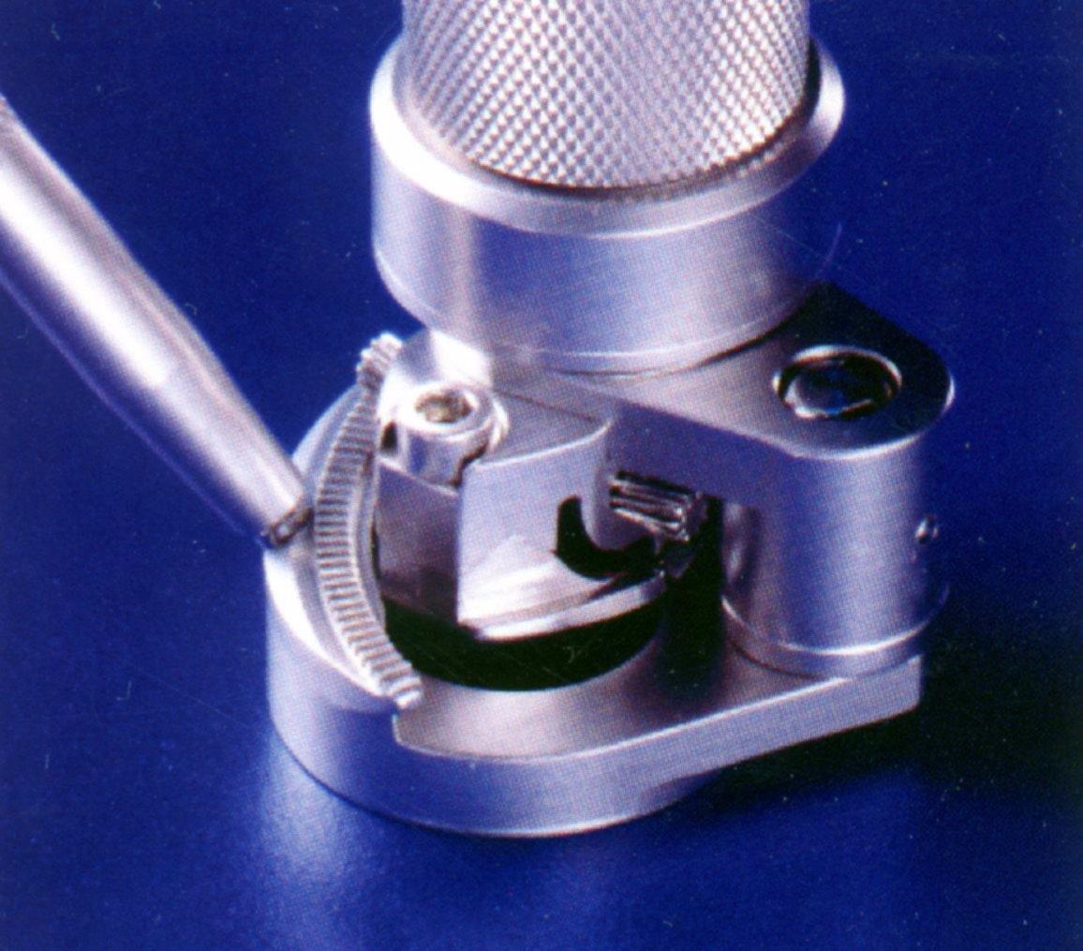
MICROKERATOME

Slide 33
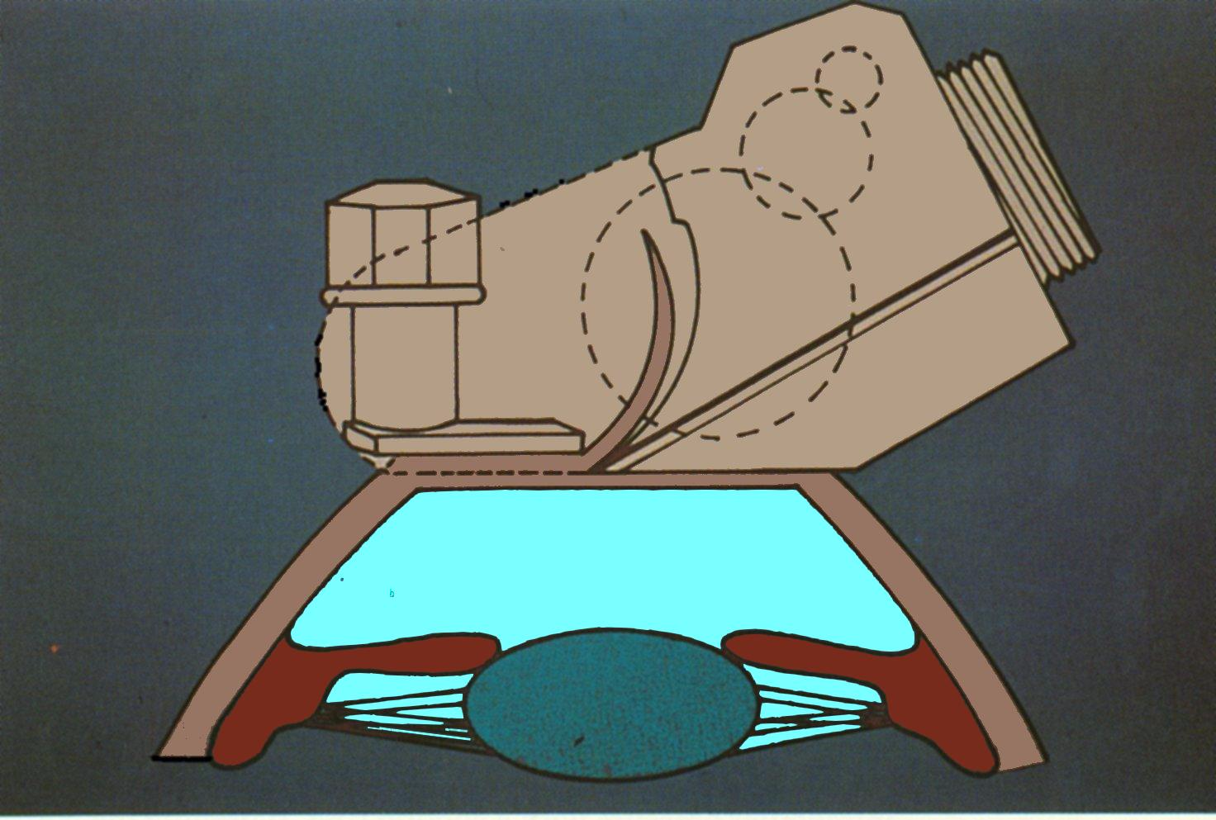
MICROKERATOME

Slide 34
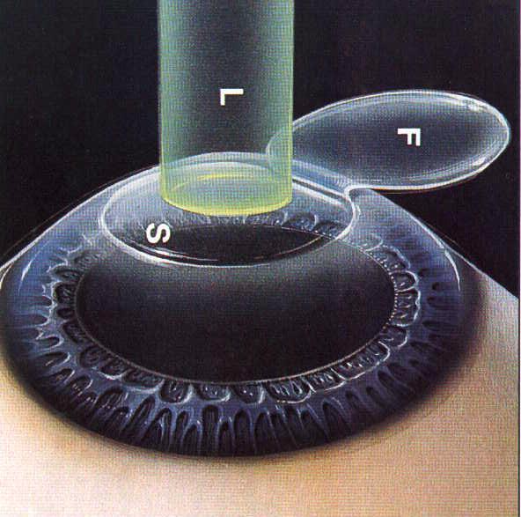
L A S I K

Slide 35
L A S I K
(laser under the corneal surface)
1. painless
2. fast visual rehabilitation
3. no corneal haze
4. short time local therapy
5. both eyes at the same day
6. excellent long term stability
Notes:
4

Slide 36
L A S I K
first choice
in
refractive surgery
Notes:
4

Slide 37
L A S I K
by femtosecond laser
Notes:
4

Slide 38
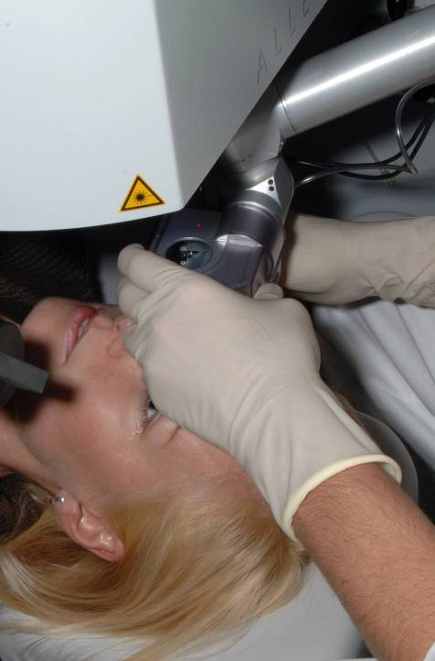
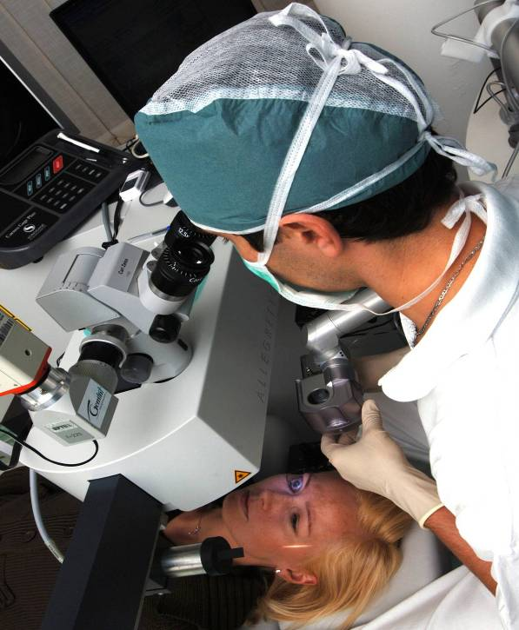

Slide 39
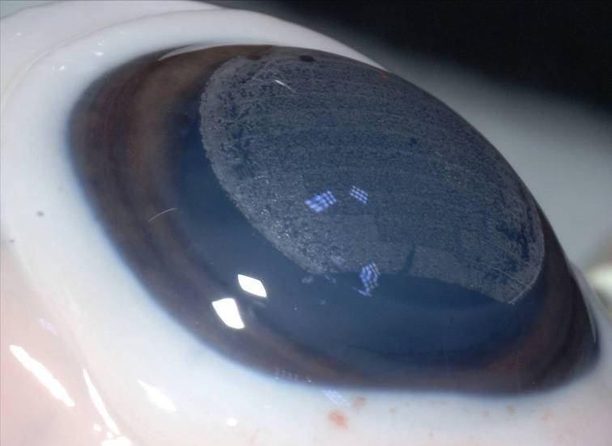
FEMTO - L A S I K
Notes:
4

Slide 40
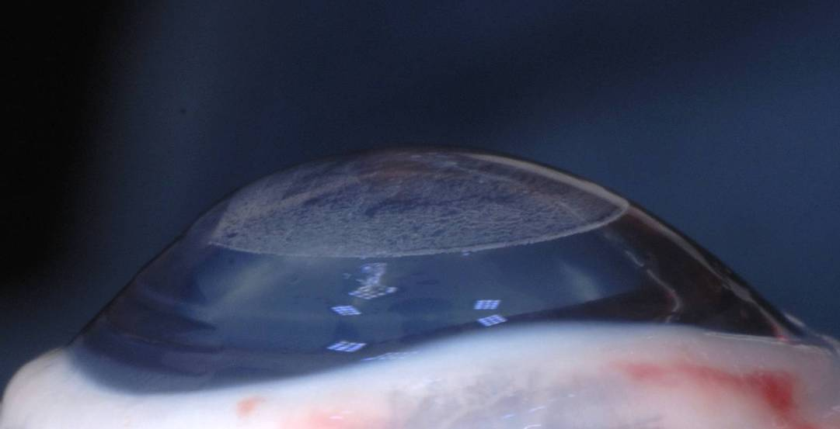
FEMTO - L A S I K
Notes:
4

Slide 41
L A S I K relex
Refractive Lenticule Extraction

Slide 42
REFRACTIVE SURGERY
laser correction of corneal curvature
a) under the surface (stromal) – LASIK, femto LASIK, Relex
b) surface (under the epithelium) - PRK, LASEK
2. corneal incisions - keratotomy – diamond knife, laser
3. intraocular lens – phakic lens
4. refractive lens exchange – similar to cataract surgery
Notes:
4

Slide 43
Surface laser ablation
(PRK, lasek)
1. accuracy fine
2. 3 days of postop. pain
3. worse stability with higher errors
4. corneal haze more probable
5. prolonged local steroid application
Notes:
4

Slide 44
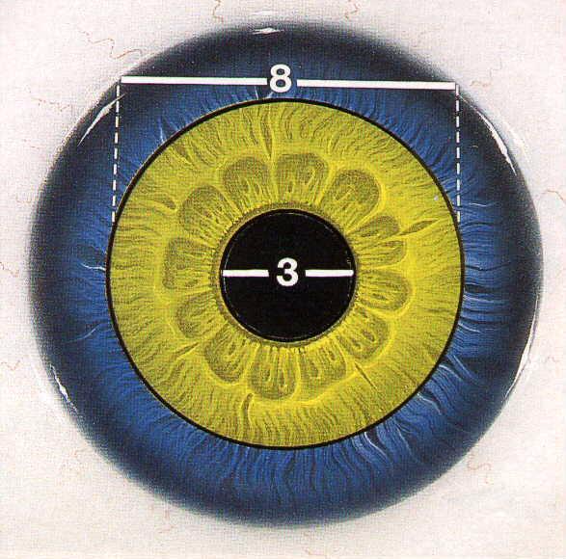

Slide 45
PRICES
Surface ablation
10 000 to 15 000 CZK
LASIK by femtosecond laser
15 000 to 25 000 CZK
Notes:
4

Slide 46
REFRACTIVE SURGERY
laser correction of corneal curvature
a) under the surface (stromal) – LASIK, femto LASIK, Relex
b) surface (under the epithelium) - PRK, LASEK
2. corneal incisions - keratotomy – diamond knife, laser
3. intraocular lens – phakic lens
4. refractive lens exchange – similar to cataract surgery
Notes:
4

Slide 47
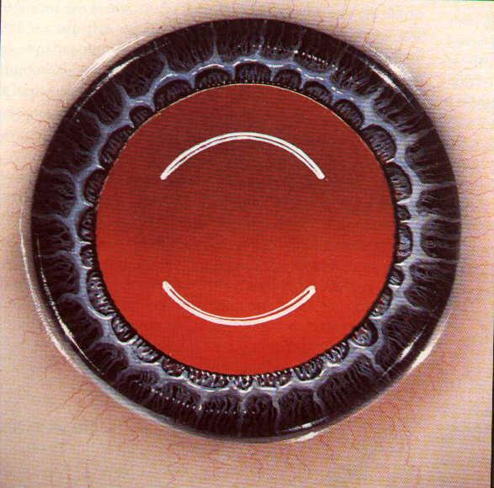
ARCAUTE KERATOTOMY
Astigmatism correction

Slide 48
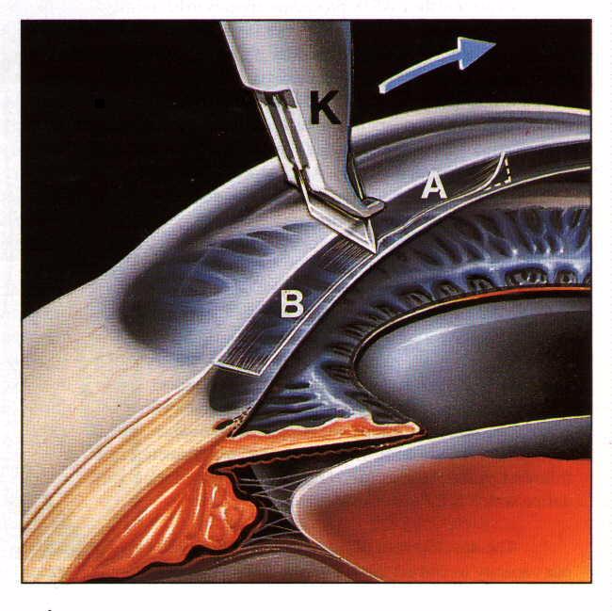
RADIAL
KERATOTOMY

Slide 49
REFRACTIVE SURGERY
laser correction of corneal curvature
a) under the surface (stromal) – LASIK, femto LASIK, Relex
b) surface (under the epithelium) - PRK, LASEK
2. corneal incisions - keratotomy – diamond knife, laser
3. intraocular lens – phakic lens
4. refractive lens exchange – similar to cataract surgery
Notes:
4

Slide 50
PHAKIC LENS
implanted into
the eye with
refractive error
Notes:
4

Slide 51
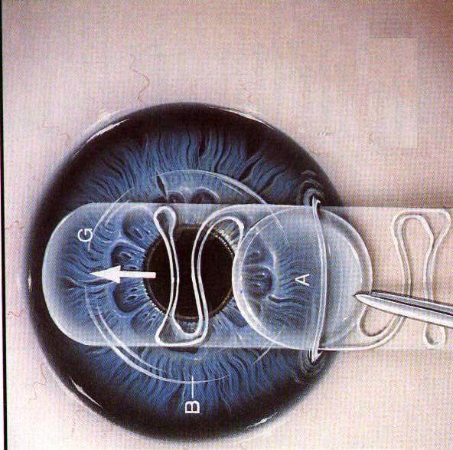
PHAKIC ANTERIOR CHAMBER
INTRAOCULAR LENS

Slide 52
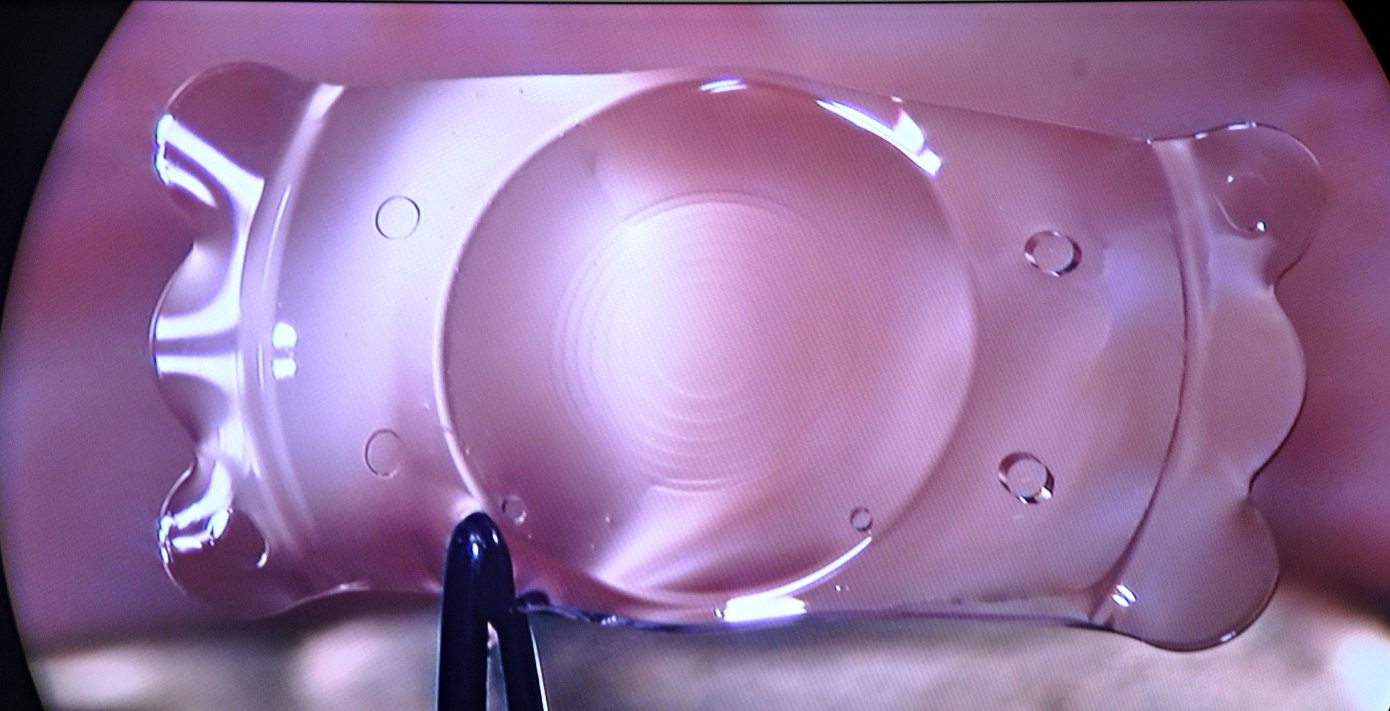
POSTERIOR CHAMBER
PHAKIC PRESBYOPIC LENS
Notes:
4

Slide 53
PHAKIC LENSES
high MYOPIA
thin cornea
Notes:
4

Slide 54
REFRACTIVE SURGERY
laser correction of corneal curvature
a) under the surface (stromal) – LASIK, femto LASIK, Relex
b) surface (under the epithelium) - PRK, LASEK
2. corneal incisions - keratotomy – diamond knife, laser
3. intraocular lens – phakic lens
4. refractive lens exchange – similar to cataract surgery
Notes:
4

Slide 55
WHERE to go for SURGERY ?
surgeron‘s skill and clinic‘s reputation
range of available surgical methods
price
distance
Notes:
4

Slide 56
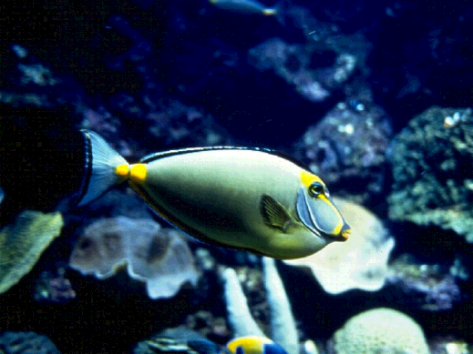
MUDr. Pavel Stodůlka,PhD.
stodulka@lasik.cz
www.LASIK.cz
humu humu nuknuku apua
Good by !
Notes:
6

